Slide 1
ROBUST ANOMALY DETECTION AND BACKDOOR ATTACK DETECTION VIA DIFFERENTIAL PRIVACY
Ana Sharma, Olivier Deschamps, Liam Kelly

Slide 2
Introduction - Detecting Backdoor attacks in Neural networks
Backdoor attacks compromise models by embedding hidden triggers in training data.
Trigger: a small pattern or feature that causes targeted misclassification.
Challenge: these attacks evade detection - models maintain high accuracy on clean test data.
Current Defenses rely on trusted datasets or assume known triggers – unrealistic in practice.
Goal of the paper:
1. Detect poisoned data without needing trusted clean sample
2. Use internal neural activations to identify behavioral anomalies in the model.
Notes:
In a backdoor attack, an adversary poisons a small portion of the training data by injecting a specific trigger—like a pattern, patch, or pixel—and labeling it incorrectly on purpose. The model learns this pattern as a hidden shortcut. So during normal use, it performs as expected, but when it sees the trigger, it suddenly misclassifies the input in a way the attacker wants.”

Slide 3
Problem Statement
Backdoor attacks are hard to detect post-training.
Attackers can poison only a few samples and still fool models reliably.
Existing defenses assume access to clean data - not always realistic.
Proposed Solution in the paper: (Chen et al.)
Use neural activations to detect poisoned samples.
Leverage differences in model behavior between clean and poisoned data.

Slide 4
Methodology: Model & Differential Privacy Mechanism
Models Used:
Feedforward Neural Networks (FNNs) and Convolutional Neural Networks (CNNs) for image classification tasks.
Trained using Stochastic Gradient Descent (SGD).
Differential Privacy (DP) Mechanism:
DP-SGD Algorithm: Ensures privacy during training.
Gradient Clipping: Limits gradient updates to a fixed value to control sensitivity.
Noise Addition: Adds noise to gradients after clipping, preventing leakage of individual data points.
Privacy Budget (ε): Controls privacy-accuracy trade-off:
Lower ε: Stronger privacy (but potentially lower accuracy).
Higher ε: Weaker privacy, better model accuracy.
Training Procedure:
Models trained over multiple epochs.
Different values of ε and noise scale tested to observe their impact on accuracy and privacy.

Slide 5
Outlier Detection - Intro
Goal: Identify poisoned or anomalous data without prior labels.
Based on model's internal representations (activations).
Applies dimensionality reduction (e.g., PCA, ICA).
Uses clustering (e.g., K-means) to detect outliers.
Flags suspicious clusters for manual review or correction.
Effective in unsupervised settings like federated or private learning.
Notes:
This slide introduces the outlier detection method used in the paper. The idea is to catch poisoned or anomalous data by analyzing how the model internally represents each input—specifically the final hidden layer activations.
Since we don’t assume we know which data is bad, we use unsupervised techniques like PCA to reduce dimensions, and clustering to find unusual patterns. Clusters that look suspicious can then be reviewed or corrected manually before the model is finalized. This is especially useful in situations where data labels aren’t trusted or privacy limits what we can access."

Slide 6
Outlier Detection - Key Findings
Dimensionality Reduction + Clustering
PCA/ICA condense features into lower dimensions.
K-means separates normal vs. anomalous data patterns.
Differential Privacy (DP)
Adds noise during training, acting as a regularizer.
Helps the model generalize and detect anomalies more effectively.
Key Findings
DP improves outlier detection, especially when many anomalies are present.
Small noise boosts robustness without hurting model accuracy.
Applications
Useful in detecting poisoned inputs and adversarial attacks.
Works well in both private and distributed learning environments

Slide 7
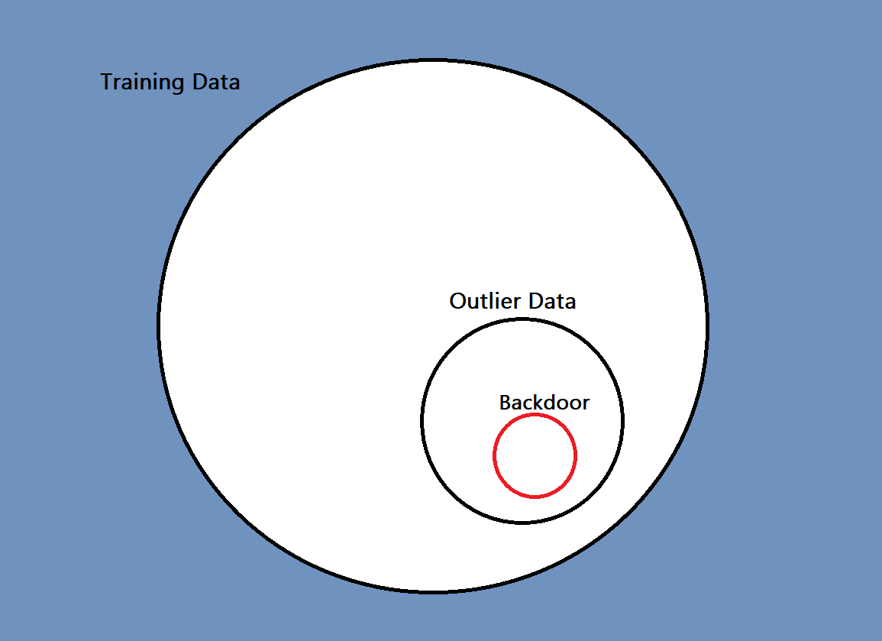
How Backdoor Differ from Outliers

Slide 8






Label Flipping Poisoning
Cats
Dogs

Slide 9
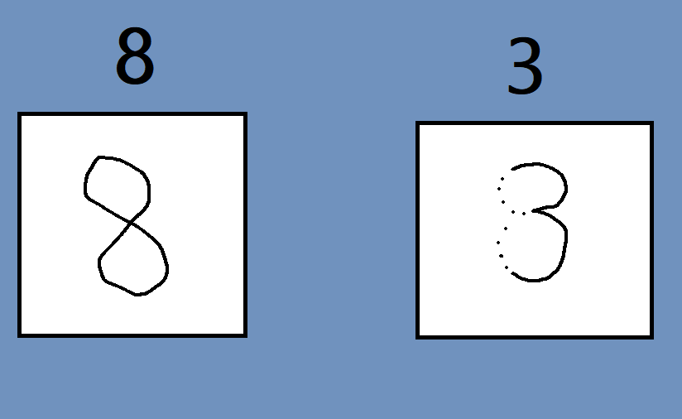
Data Injection Poisoning

Slide 10
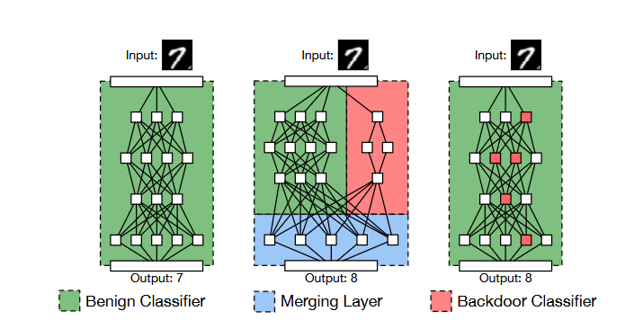
Architecture Manipulation

Slide 11
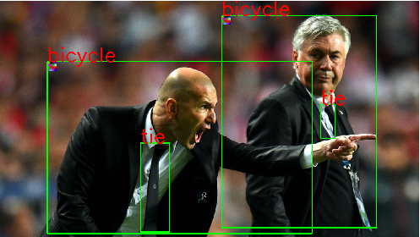

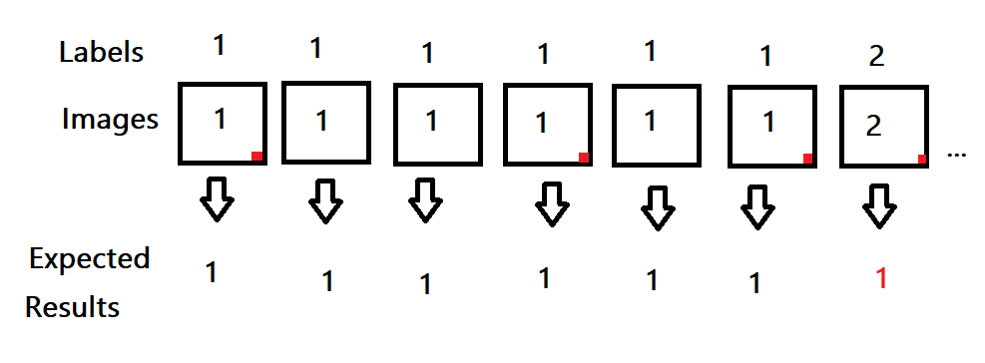
Backdoor Poisoning

Slide 12
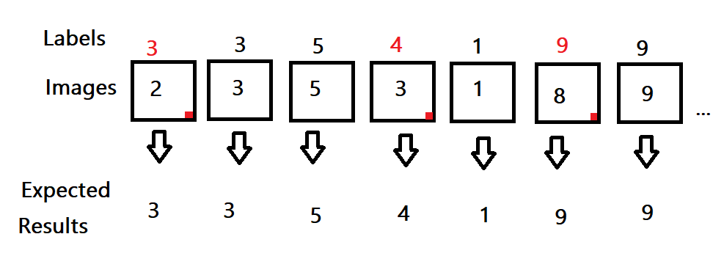
Poisoning they focus on in the paper
(Label + 1) % 10

Slide 13
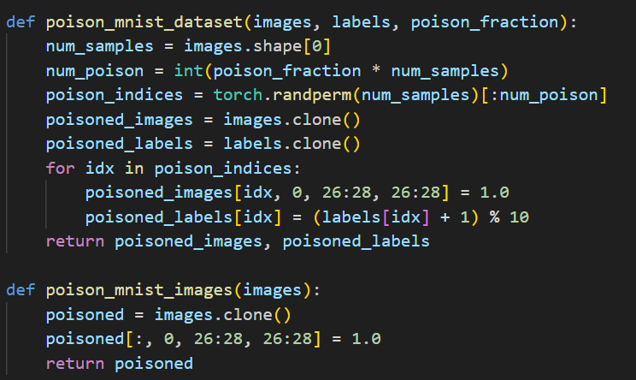
How does this actually work.
Training model
with poisoned Data
Testing
model prediction

Slide 14
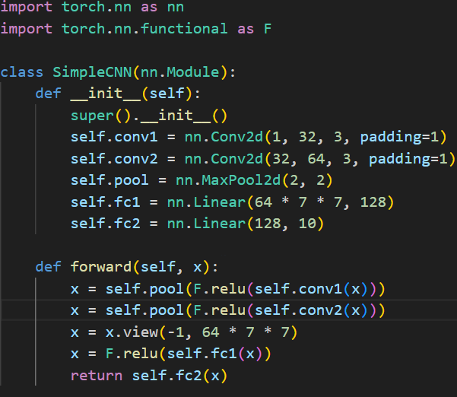
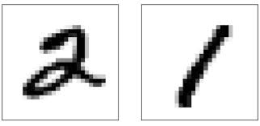
Convolution Neural Network
Deep Learning model that is designed to work on grid-like data
Uses convolutional layers to automatically extract features - Instead of manually defining what features to look for, CNNs learn filters that scan the image and highlight important patterns like edges or color transitions.
Unlike a traditional neural network, CNN will maintain the spatial relationship between pixels. Pixels close to each other are considered related.
Pattern recognition within images is flexible and the position of the object in the image will not affect the determination made by the model
These features make the model ideal for MNIST.
Deep Learning model that is designed to work on grid-like data
Uses convolutional layers to automatically extract features - Instead of manually defining what features to look for, CNNs learn filters that scan the image and highlight important patterns like edges or color transitions.
Unlike a traditional neural network, CNN will maintain the spatial relationship between pixels. Pixels close to each other are considered related.
Pattern recognition within images is flexible and the position of the object in the image will not affect the determination made by the model
These features make the model ideal for MNIST.

Slide 15
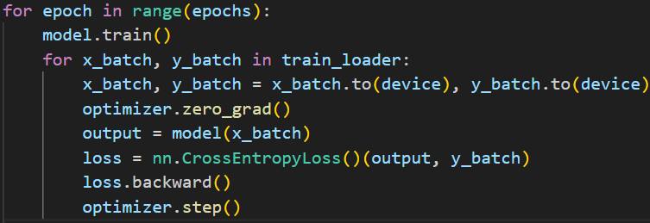
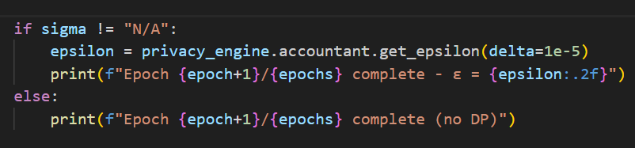
Model Training
Optionally uses Opacus for Differential Privacy (sigma NOT “N/A”)
Injects Gaussian noise and clipping during gradient updates
Tracks privacy budget (ε) per epoch
Training loop over epochs, batch_size = 512
CNN model trained using Cross Entropy Loss
Optionally uses Opacus for Differential Privacy (sigma NOT “N/A”)
Injects Gaussian noise and clipping during gradient updates
Tracks privacy budget (ε) per epoch
Training loop over epochs, batch_size = 512

Slide 16
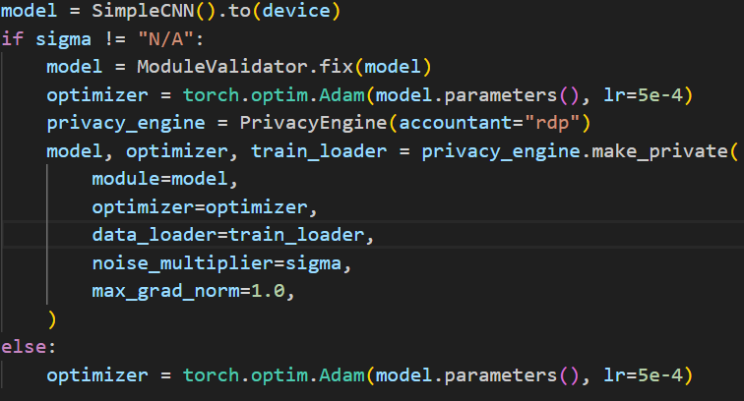
How is Differential Privacy Added?
Per-Sample Gradients
Computes gradients individually for each sample instead of the whole batch.
Gradient Clipping
Clips each sample’s gradient to a fixed L2 norm (max_grad_norm)
Limits any single example’s influence on the model
This is why sigma = 0 still affects the model!
Add Gaussian Noise
Adds random noise (scaled by sigma) to the sum of clipped gradients
Obscures individual sample contributions
Privacy Accounting (ε)
Tracks privacy budget using Rényi Differential Privacy (RDP)
Reports total ε after each epoch
Per-Sample Gradients
Computes gradients individually for each sample instead of the whole batch.
Gradient Clipping
Clips each sample’s gradient to a fixed L2 norm (max_grad_norm)
Limits any single example’s influence on the model
This is why sigma = 0 still affects the model!
Add Gaussian Noise
Adds random noise (scaled by sigma) to the sum of clipped gradients
Obscures individual sample contributions
Privacy Accounting (ε)
Tracks privacy budget using Rényi Differential Privacy (RDP)
Reports total ε after each epoch

Slide 17
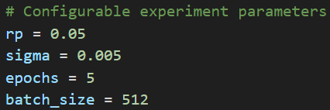
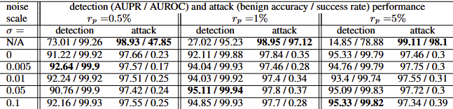
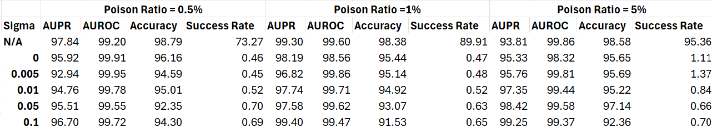
Final Parameters Used and Data Results

Slide 18
Q&A

Slide 19
References-
https://openreview.net/pdf?id=SJx0q1rtvS
https://arxiv.org/pdf/2205.14497
https://github.com/Trusted-AI/adversarial-robustness-toolbox/blob/main/notebooks/poisoning_attack_bad_det.ipynb
https://github.com/Trusted-AI/adversarial-robustness-toolbox/blob/main/notebooks/poisoning_attack_bad_det.ipynb

Slide 20
Thank you !

